Slide 1

this vs super
Let's discuss the difference between the this, and the super keywords.
We'll also find out about the differences between the this(), and super(), method calls.
COMPLETE JAVA MASTERCLASS
this vs super

Slide 2
this vs super
Let's start with the super, and the this keywords first.
The keyword super is used to access or call the parent class members (variables and methods).
The keyword this is used to call the current class members (variables and methods).
this is required, when we have a parameter with the same name, as an instance variable or field.
NOTE: We can use either of them anywhere in a class, except for static elements, like a static method. Any attempt to do so there, will lead to compile time errors.
COMPLETE JAVA MASTERCLASS
this vs super

Slide 3
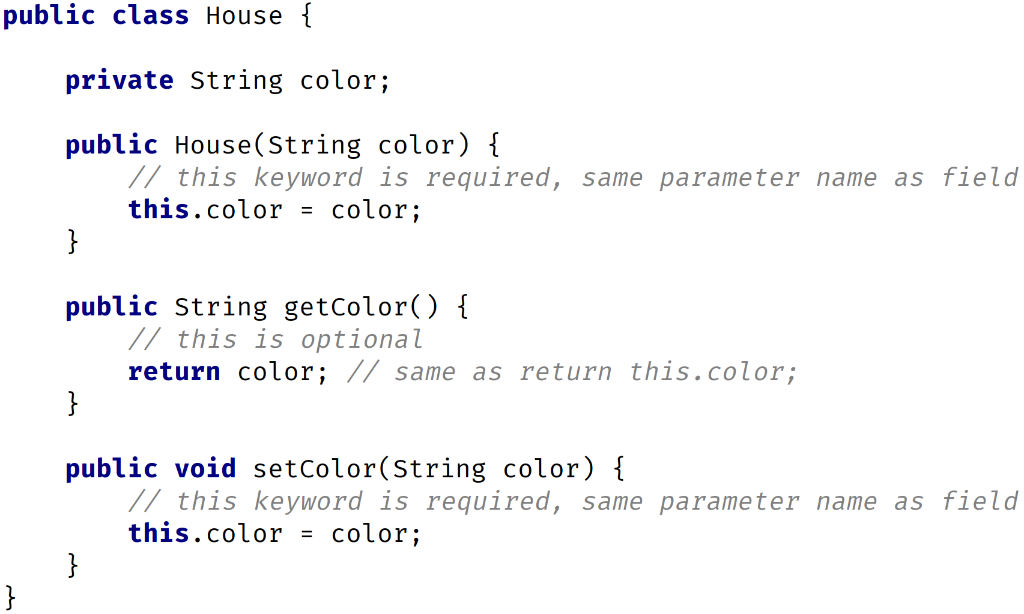
Keyword this
The keyword this, is commonly used with constructors and setters, and optionally used in getters.
In this example, we're using the this keyword in the constructor and setter, since there's a parameter with the same name, as the instance or field.
In the getter we don't have any parameters, so there's no conflict, so therefore the this keyword is optional there.
COMPLETE JAVA MASTERCLASS
this vs super

Slide 4
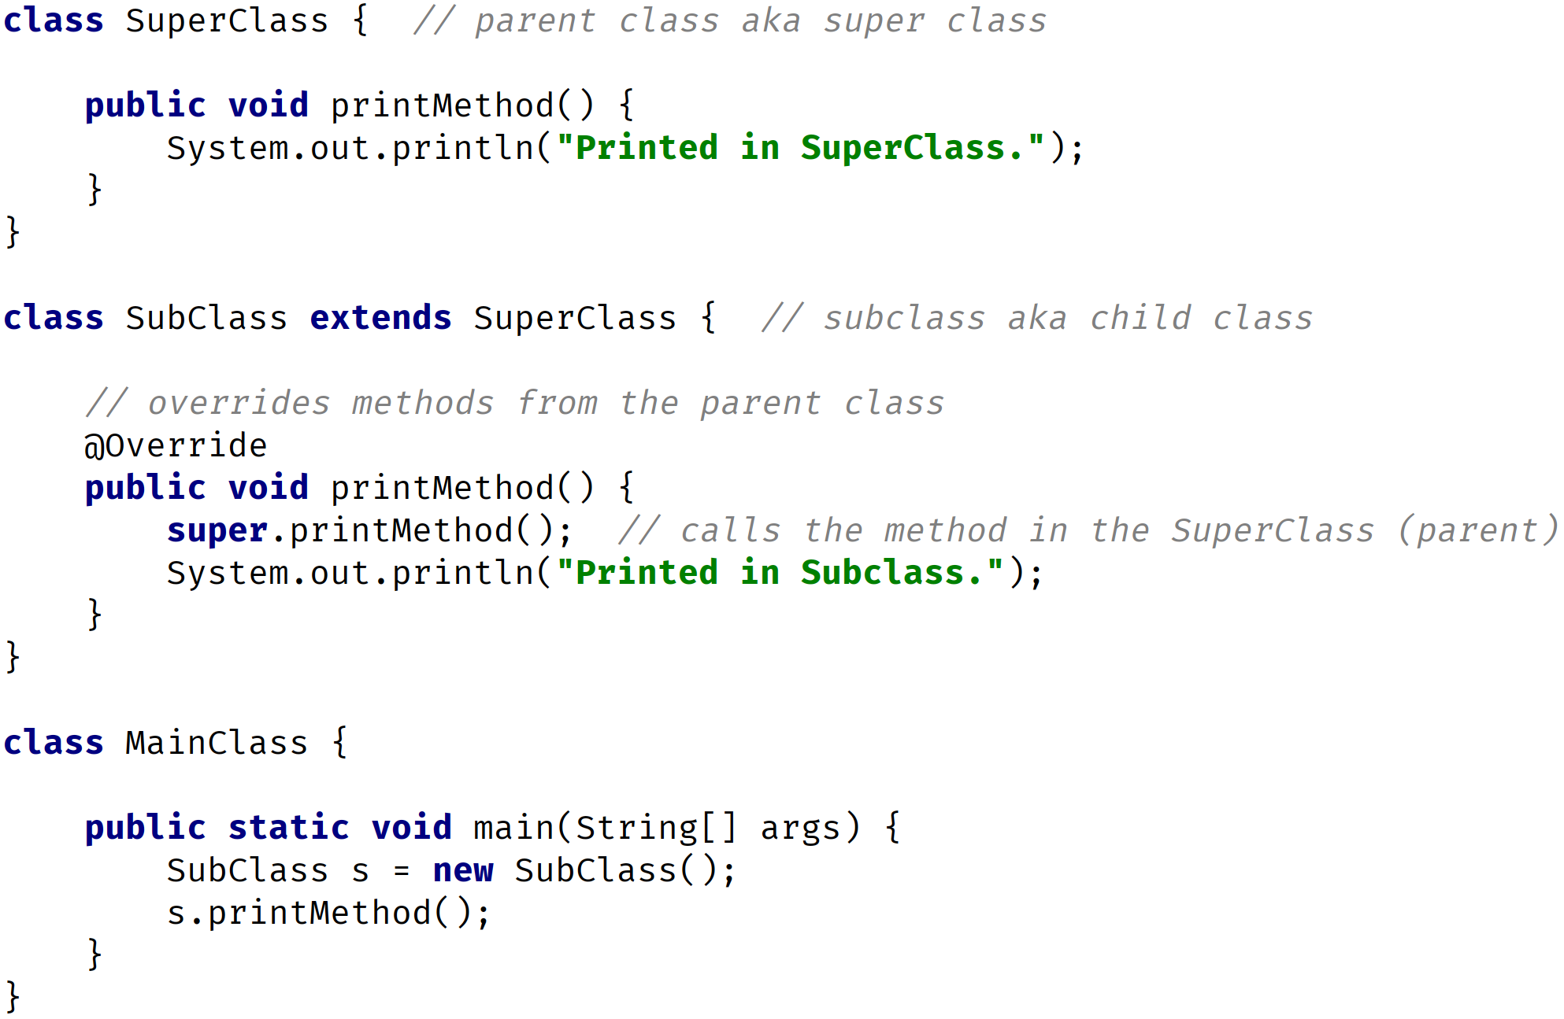
Keyword super
The keyword super, is commonly used with method overriding, when we call a method with the same name, from the parent class.
In this example, we have a method called printMethod, that calls super.printMethod.
COMPLETE JAVA MASTERCLASS
this vs super

Slide 5
this() vs super() call
In Java we've got the this() and super() call. Notice the parentheses.
These are known as calls, since it looks like a regular method call, although we're calling certain constructors.
Use this() to call a constructor, from another overloaded constructor in the same class.
The call to this() can only be used in a constructor, and it must be the first statement in a constructor.
It's used with constructor chaining, in other words when one constructor calls another constructor, and it helps to reduce duplicated code.
The only way to call a parent constructor, is by calling super(), which calls the parent constructor.
COMPLETE JAVA MASTERCLASS
this vs super

Slide 6
this() vs super() call
The Java compiler puts a default call to super(), if we don't add it, and it's always a call to the no argument constructor, which is inserted by the compiler.
The call to super() must be the first statement in each constructor.
A constructor can have a call to super() or this(), but never both.
COMPLETE JAVA MASTERCLASS
this vs super

Slide 7
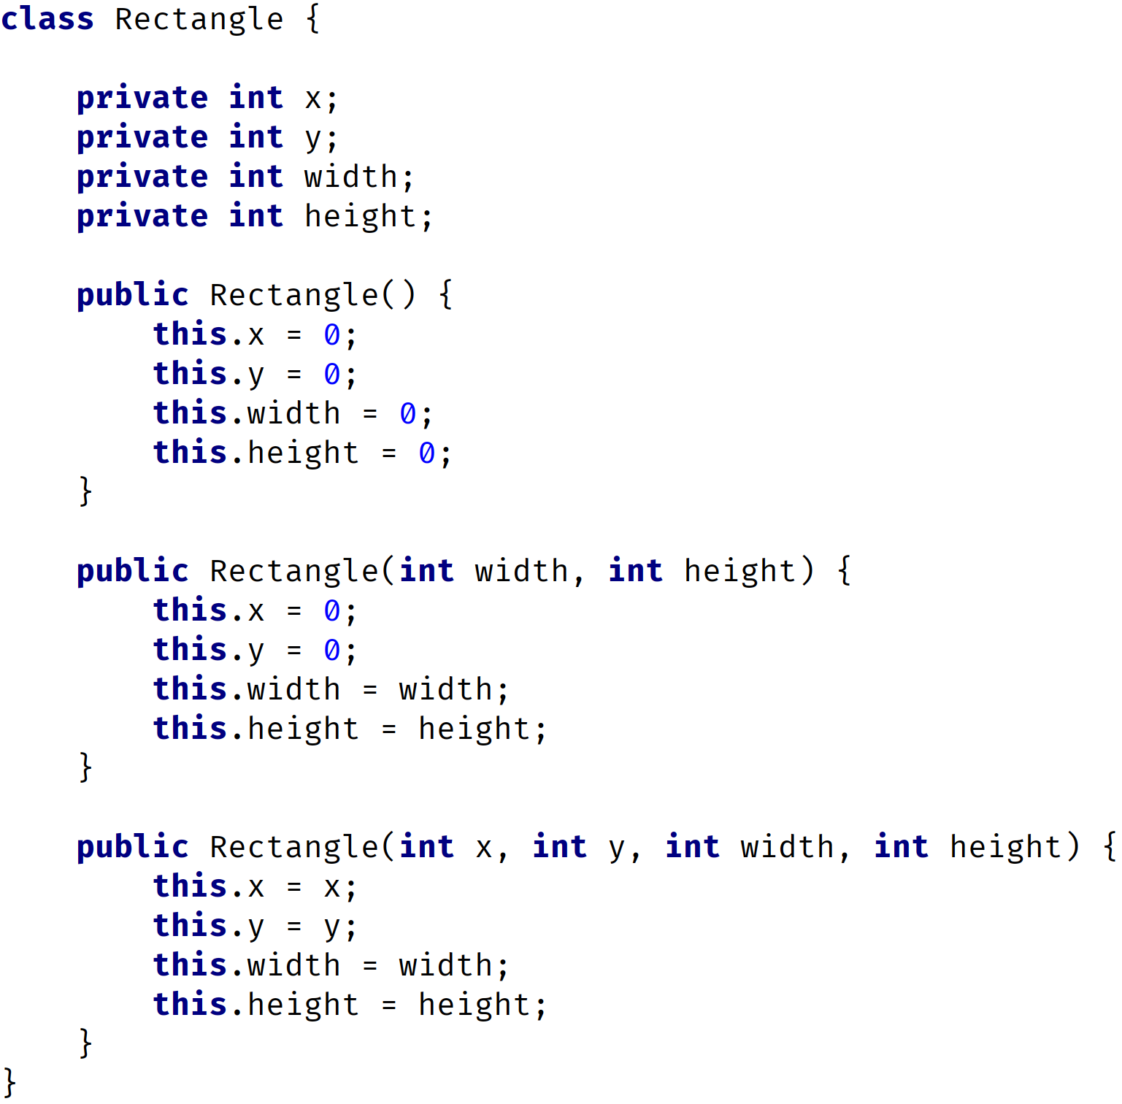
Constructors Bad Example
Here, we have three constructors.
All three constructors initialize variables.
There's repeated code in each constructor.
We're initializing variables in each constructor, with some default values.
You should never write constructors like this.
Let's look at the right way to do this, by using a this() call.
COMPLETE JAVA MASTERCLASS
this vs super

Slide 8
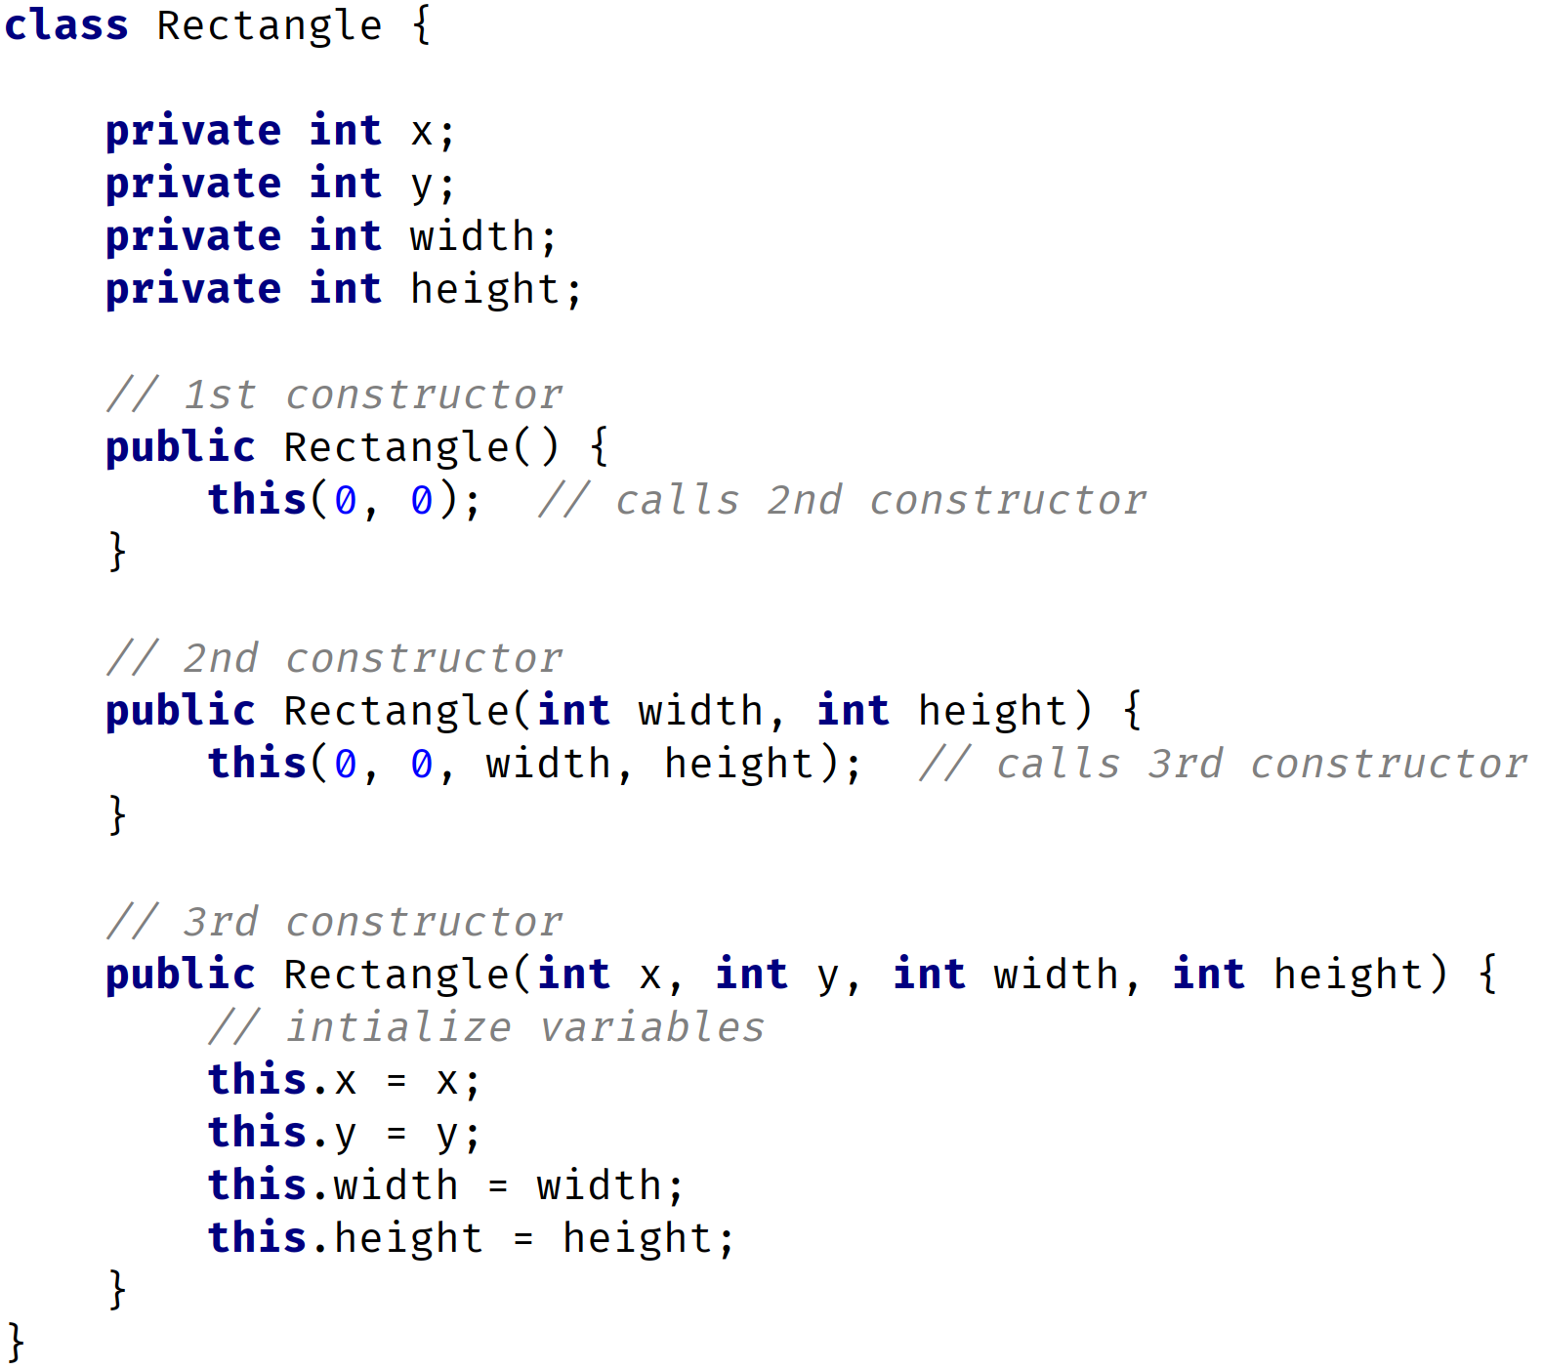
Constructors Good Example
In this example, we still have three constructors.
The 1st constructor calls the 2nd constructor, the 2nd constructor calls the 3rd constructor, and the 3rd constructor initializes the instance variables.
The 3rd constructor does all the work.
No matter what constructor we call, the variables will always be initialized in the 3rd constructor.
This is known as constructor chaining, the last constructor has the responsibility to initialize the variables.
COMPLETE JAVA MASTERCLASS
this vs super

Slide 9
Comparing Both Examples
BAD
GOOD
COMPLETE JAVA MASTERCLASS
this vs super

Slide 10
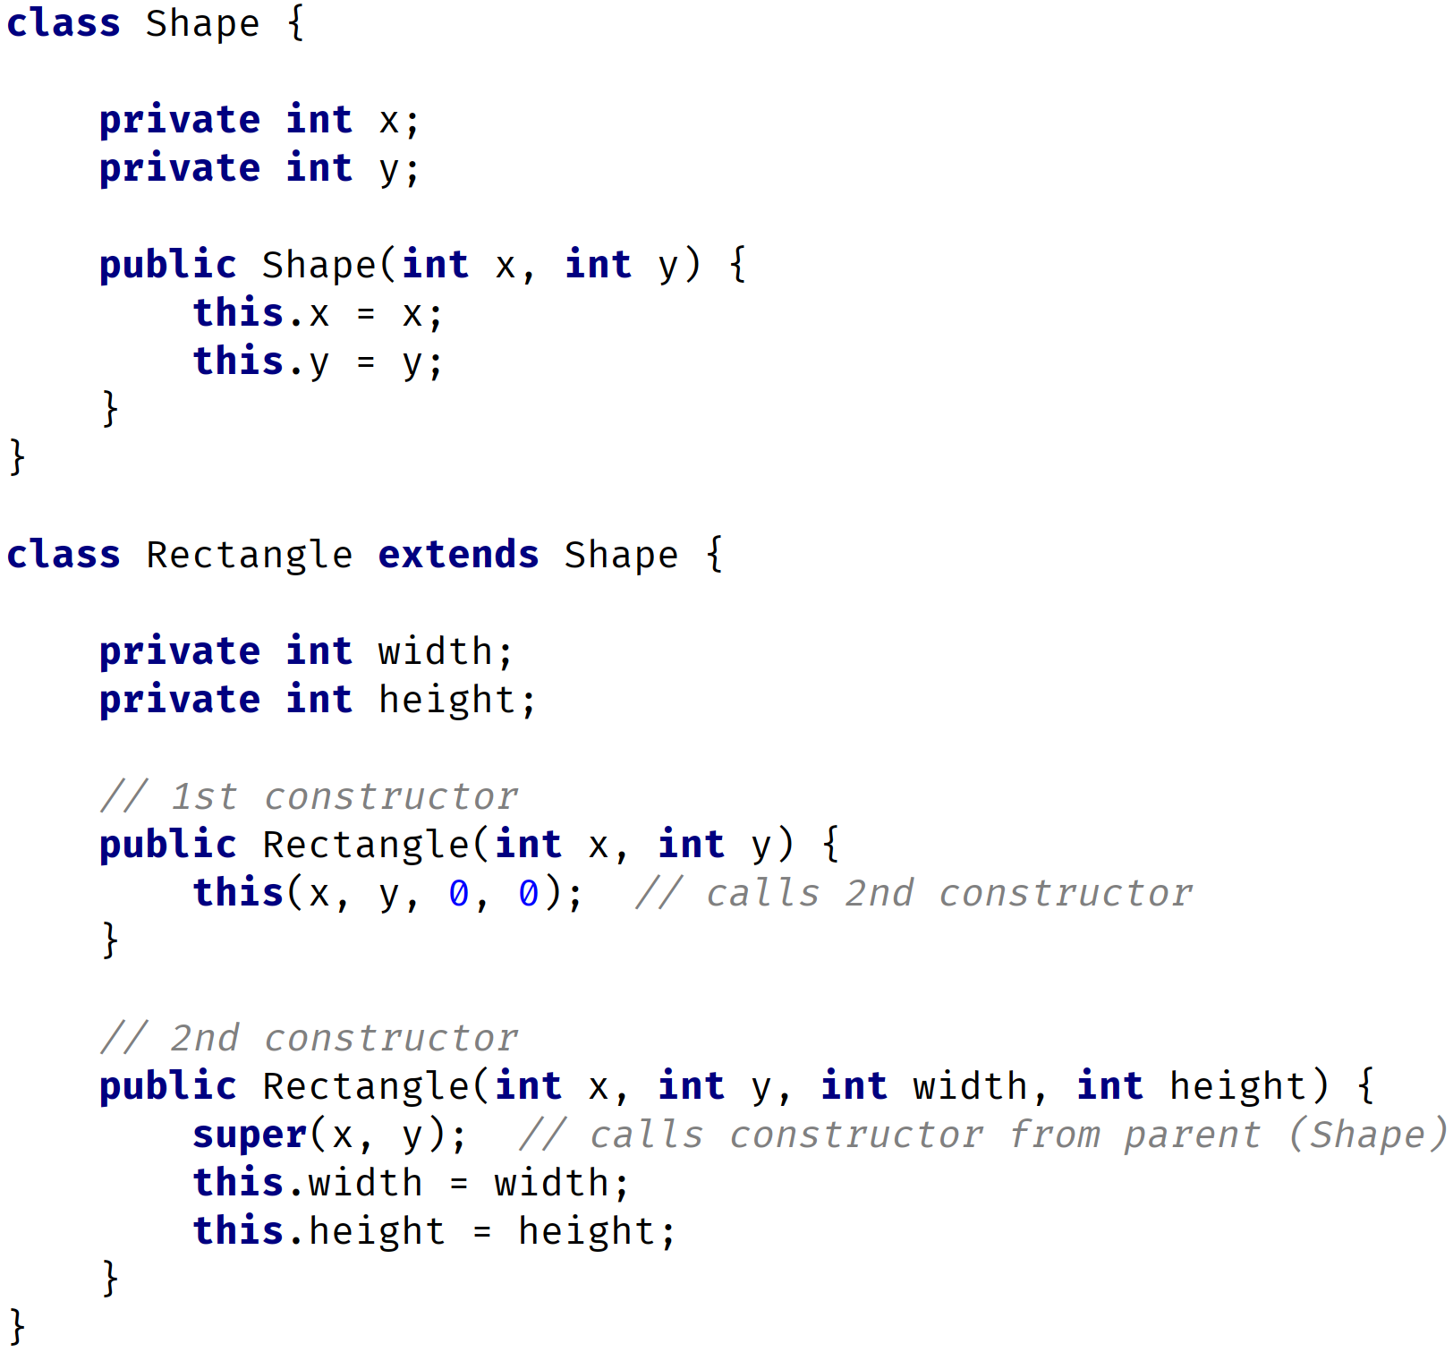
super() call example
In this example, we have a class Shape, with x and y variables, and a class Rectangle that extends Shape, with variables width and height.
In the Rectangle class, the 1st constructor is calling the 2nd constructor.
The 2nd constructor calls the parent constructor, with parameters x and y.
The parent constructor will initialize the x and y variables, while the 2nd Rectangle constructor will initialize the width and height variables.
Here, we have both the super() and this() calls.
COMPLETE JAVA MASTERCLASS
this vs super

